Slide 1
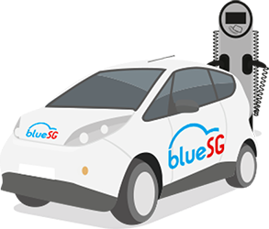
Sentiment Analysis
of Tweets on Electric Car-sharing Service, BlueSG
Prepared by Krystal Chee Jia Qi
PI Number: B1981108

Slide 2
01
Table of Contents
02
03
04
05
06
07
Introduction
Business Problem, Objective & Text Mining Objective
Modelling Methodology
Data Understanding & Preparation
Modeling Results
Evaluation & Recommendations
Conclusion
Notes:
My presentation will contain the..
Introduction of my project
Understanding the business problem, object and text mining objective…
The Modelling methodology i will be using
My data understanding and preparation
My modelling results
Evalution and recommendations for bluesg
And the Conclusion

Slide 3

Introduction
Climate Change
Paving the road to greener transport with car sharing and Evs
Singapore Green Plan
To have cars with internal combustion engines to be phased out, and all vehicles run on greener energy
BlueSG
The world’s second biggest electric car-sharing service
Notes:
Electric vehicles (EVs) itself are an important part of meeting global goals on climate change bc they effective pave the road to mitigating global warming for more sustainable transportation. The Singapore government has launched the Singapore Green Plan 2030 (SGP30) as part of the country's efforts to combat climate change. Bluesg began operations here in 2017, in partnership with the Land Transport Authority and the Economic Development Board, as part of efforts to make Singapore’s transport system more sustainable. However, BlueSG since its launch. It reportedly made a loss of $3.4 million in 2017, $7.3 million in 2018, and $9.3 million in 2019.
Nowadays, before buying a product or a service, the customers seek reviews to learn from others’ experience be it from social media, blogs or website comments. In my project, I will propose approaches which predicts tweets on bluesg based on sentiment analysis and topic modelling. Sentiment analysis proves to be very effective in businesses and social domains because opinions are critical for all human activities, bluesg can leverage on it to capture valuable insights of its business.
Note:
- according to data from the Accounting and Corporate Regulatory Authority,

Slide 4

Understanding the problem
Text Mining Objective
Business Problem
Business Objective
Lack of willingness to adjust to Evs due to concerns and unfamiliarity
Strengthen BlueSG’s brand awareness and improve customer experience
Perform sentiment analysis on tweets made about BlueSG to better understand the consumers’ perceptions and feelings
Help BlueSG formulate strategies to improve customer experience and improve customer satisfaction
Notes:
- Firstly, we need to understand the problems and objective of bluesg. With Electric vehicles (EVs) and carsharing being a developing and modern kind of transportation. There is a lack of willingness to adjust to the difficulties of using an electric vehicle in Singapore because of significant disadvantages and unfamiliar usages such as the cost of service, charging and parking aspects.
- Therefore, the objective of this project is to strengthen BlueSG’s brand by identifying customer pain points across the business, find out what needs to be improved and make recommendations based on social media reviews to increase customer experience and better brand awareness.
-The Text mining objective would be to perform sentiment analysis as it can help determine the sentiment of tweets and facilitate bluesg in their Customer Relationship Managment. Furthermore, by aggregating the sentiment expressed by multiple users, it is possible to identify problems in its products or services, evaluate the opinion and perception that consumers have and discover the needs of customers.

Slide 5




Modeling Methodology
Web Scraping using Twitter’s API, Tweepy and Snscrape
The extraction of data from a website. Twitter’s API gives access to tweets, entities, places and users.
Unsupervised lexicon-based approach
Sentiment Analysis and Classification using Affin
Classifies tweets as positive, negative or neutral based on the contextual sentiment orientation of the words
Wordlist-based approach for sentiment analysis to obtain and predict polarity of tweets
LDA Topic Modelling with pyLDAvis
Analyze and create highly interactive visualization of the clusters created by Latent Dirichlet Allocation (LDA).
Notes:
These are the methodologies i used for this project.
-According to existing Sentiment Analysis methods, it is dominated by two main approaches: lexicon-based and corpus-based. For my project, I decided on the lexicon-based approach. In lexicson-based sentiment analysis, words in texts are labeled as positive or negative with the help of a dictionary of lexicons that can be created manually or automatically generated. Lexicon us a list of lexical words that are labeled with positive of negative based on the semantic meaning, with a positive or negative sentiment score assigned to each word.
-I first did a web scraping with pythom to scrape data from twitter using tweepy and snscrape which are python libraries for intergrating and extracting tweets with twitter’s API. Next, I utilised another python library, Afinn, which is the simplest yet popular lexicons used for sentiment analysis. It contains 3300+ words with a polarity score associated with each word. In python, there is an in-built function for this lexicon.
-And finally, I performed an LDA Topic modelling where the automated model analyzes the text data and creates the clusters of the words from that dataset or a combination of documents. It works on finding out the topics in the text and find out the hidden patterns between words relates to those topics. Afterwhich, I created an interactive visualization of the clusters to better understanding and interpreting individual topics.
Note:
- Supervised learning is a machine learning approach that’s defined by its use of labeled datasets. These datasets are designed to train or “supervise” algorithms into classifying data or predicting outcomes accurately. Using labeled inputs and outputs, the model can measure its accuracy and learn over time.
Unsupervised learning uses machine learning algorithms to analyze and cluster unlabeled data sets. These algorithms discover hidden patterns in data without the need for human intervention (hence, they are “unsupervised”).
Unsupervised learning models, in contrast, work on their own to discover the inherent structure of unlabeled data.

Slide 6
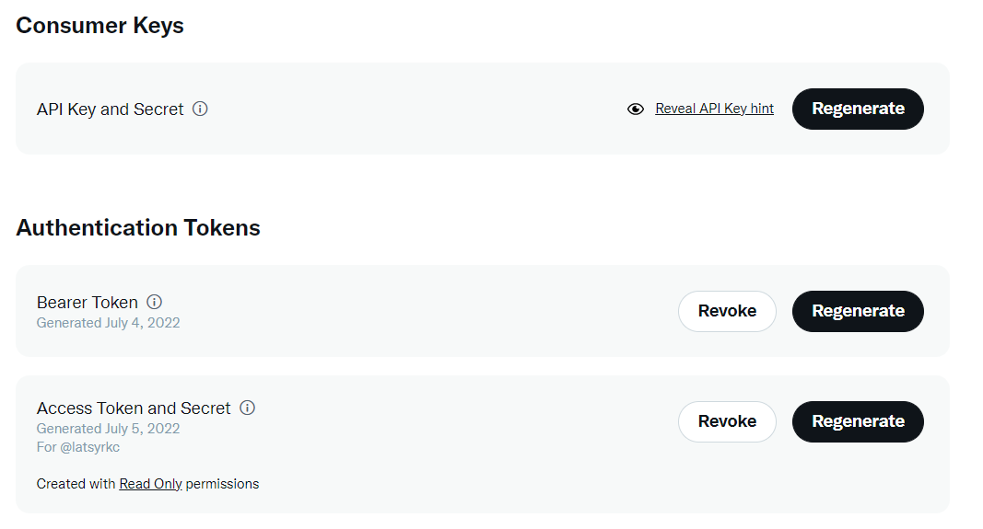

Data Understanding & Preparation
Creating Twitter developer portal to access Twitter’s API
Assigning polarity scores and categories
Where:
Polarity score > 0 = Positive
Polarity score = 0 = Neutral
Polarity score < 0 = Negative
Data cleaning and text-preprocessing:
- Decoding HTML
- Removal of URLs, username, punctuations
- Removal of stopwords
Using Python sns scraper to extract tweets pertaining to BlueSG
Notes:
During my data preparation stage,
First, I had to set up a developer account in order to access twitter API
Using python to extract tweets and also using consumer keys and authentication tokens from twitter developer portal which are credentials required to access twitter’s API.
Using python to perform data cleaning and text-preprocessing such as…
Using affin, i assigned polarity scores and classes to predict the polarity of tweets. So that I can create prediction model on sentiments.

Slide 7
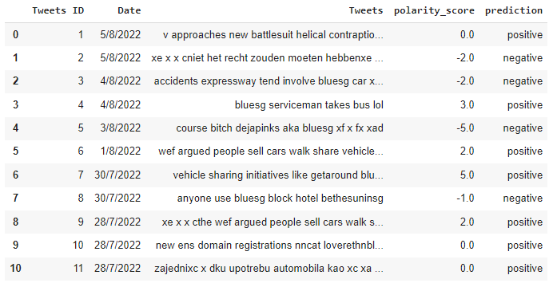
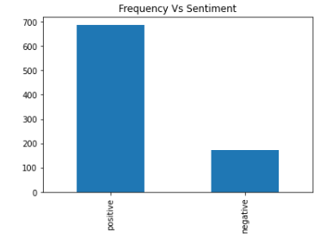
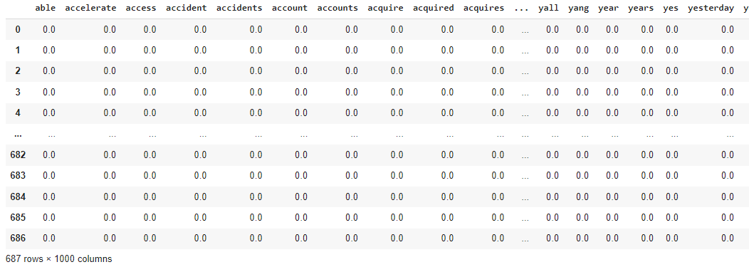
Modeling Results - Predicting polarity using Affin
Creating polarity scores and assigning class
Prediction Data
Word Embedding: Convert texts to numbers using term frequency–inverse document frequency (TF-IDF) vectorizer
Notes:
-Here you can see how the data looks after cleaning, formatting, creating polarity scores and assigning sentiment classes to the tweets. The AFINN lexicon assigns words with a score that runs between -5 and 5, with negative scores indicating negative sentiment and positive scores indicating positive sentiment. For instance, I circled in red a tweets with a 3.0 positive polarity score and another with -5.0 indicating a negative polarity score.
-From the bar chart plotted, we can get a sense of the distribution of sentiment here. We can see that there are more positive tweets then negative ones. Which shows the general distribution of emotional perception of tweets on bluesg being overall positive. This tells me that from this sentiment analysis, users or customers of bluesg are generally satisfied and has a positive brand perception.
-Once I have the sentiment for every tweet. I wanted to see how good are my predictions. For that I created a train and test data.
Firstly, I converted my tweet columns to numerical values by vectorization as seen above. So that i can build a model for sentiment classification to see how good polarity is being detected. I then decided on 20%-80% split of my dataset between testing and training stages, ensuring at least 75% of data goes into training. (to avoid overfitting)

Slide 8
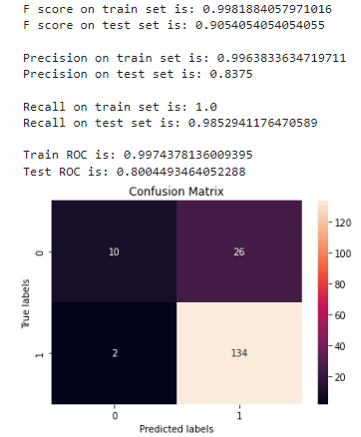
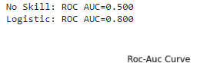
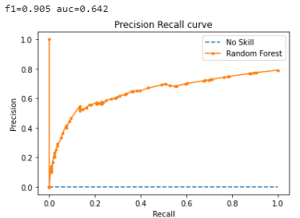
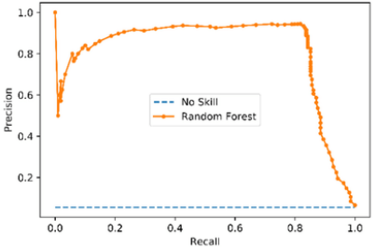

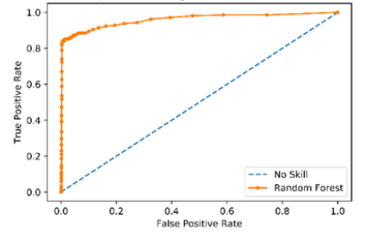
Modeling Results - Predicting polarity
Accuracy Performance Metrics: Confusion matrix, Precision, Recall, F1 Score and ROC
= 2*(precision*recall) / (precision + recall)
= TPos / (TPos+TNeg+TNeu)
= TPos / (TPos+FNeg+FNeu)
Notes:
-Afterwhich, I use the data from the testing set to gauge the accuracy of prediction. The results can be seen in the confusion matrix, which is a performance measurement technique where it measures precision, recall, f-score and ROC of my model. A confusion matrix helps us gain an insight into how correct our predictions were and how they hold up against the actual values. The x-axis are the predicted labels (0,1) and the y-axis are the actual labels (0,1). 0,1 represents the different classes respectively so label 0 is negative sentiment, 1 is positive sentiment.
-As per the model prediction, there are 2 instances that are wrongly classified as negative and 26 instances that are wrongly classified as positive out of a sample size of 172 for test set. The rest circled in red are all the data that have been classified correctly for its sentiments for actual outcomes against the predicted outcome. Having a 0 instances would mean that the model is performing perfectly. The goal of this confusion matrix would be to maximise the values of the True Positive andTrue Negative sentiments. The best performance in terms of correct classification would be the positive sentiment with 134 being correctly classified, followed by 10 being negative sentiment correctly classified.
-When looking at the precision and recall. Precision shows what percentage of the positive predictions made is correct, meaning, of all tweets classified as positive, how many of them are actually positive. The precision on my test set is 0.837, in other words, when it predicts that a tweet is positive, it is correct around 84% of the time. Recall shows what percentage of actual positive predictions were predicted, meaning how much of the actual tweets that are positive were also predicted positive. The recall on my test set is 0.985, in other words, it correctly identifies 99% of all positive tweets. We can see that there is higher recall performance then precision performance.
-Next, looking the ROC curve and Precision-recall curve for the model. These two curve are the most common measures to demonstrate the performance of a prediction model. The modes showed a f-score of 0.905 or 91% for the polarity prediction and the area under the ROC is 0.8 indicating a good precision and recall performance. This means the model is very accurate and has a high sentivity and specificity with high prediction of the sentiment of tweets.
Note:
TF-IDF: It is a method of extracting the features from the text data. TF stands for Term Frequency and IDF stands for Inverse Document Frequency.
Overfitting is the case when your model represents the training dataset a little too accurately. This means that your model fits too closely. In the case of overfitting, your model will not be able to perform well on new unseen data. Overfitting is usually a sign of model being too complex.
Test set: A set of examples used only to assess the performance of a fully-specified classifier.
The precision is intuitively the ability of the classifier not to label as positive a sample that is negative.
The recall is intuitively the ability of the classifier to find all the positive samples.
Sensitivity: The probability that the model predicts a positive outcome for an observation when indeed the outcome is positive. This is also called the “true positive rate.”
Specificity: The probability that the model predicts a negative outcome for an observation when indeed the outcome is negative. This is also called the “true negative rate.”
An ROC curve (receiver operating characteristic curve) is a graph showing the performance of a classification model at all classification thresholds. This curve plots two parameters: TPR and FPR. TPR = TP/(TP+FN). FPR = FP / (FP+TN).

Slide 9
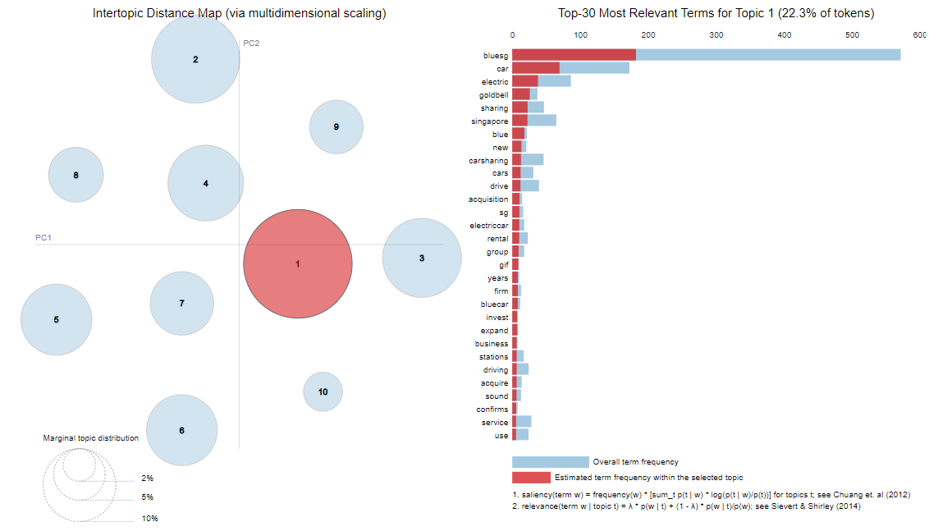
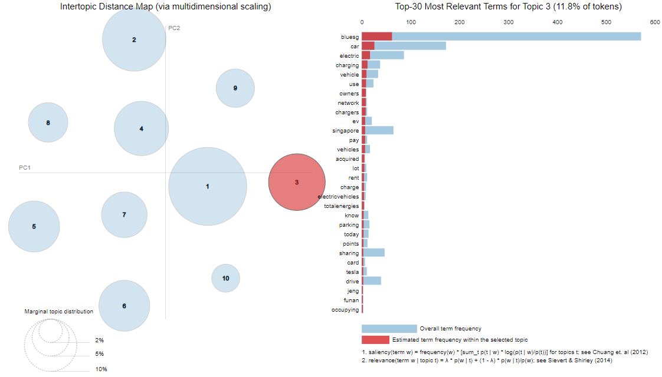
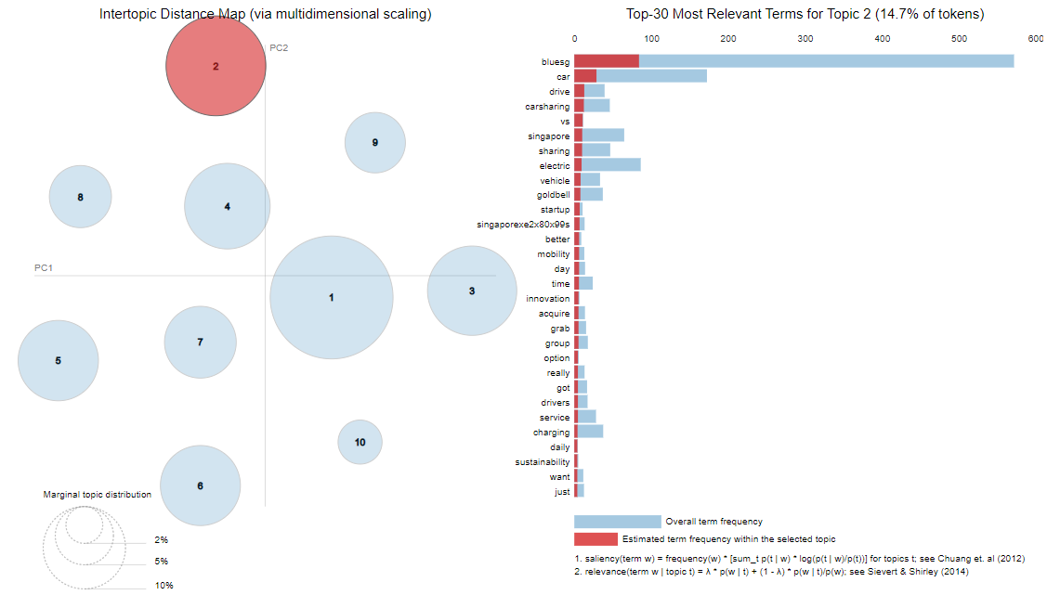
Modeling Results - Topic Modelling
Categories
Bubble 1 – Politics/Business | Bubble 2 - Aspects | Bubble 3 - Service
Goldbell | Mobility | Chargers
Acquisition | Time | Pay
Rental | Innovation | Rent
Invest | Charging | Parking
Expand | Sustainability | Points
Notes:
The topic modelling here works on finding out the topics in the text and find out the hidden patterns between words relates to those topics. My LDA topic model is built with 10 different topics where each topic is a combination of keywords, and each keyword contributes a certain weightage to the topic.
The Intertopic Distance Map on the left half of this chart represents each topic as a bubble, the size correlates to the prevalence of its topic within the text document. Blue bars represent the overall frequency of each word in the corpus. Red bars give the estimated number of times a given term was generated by a given topic. For example, from this figure here, there are about 550 of the word ‘bluesg’, and this term is used about almost 200 times within topic 1. The word with the longest red bar is the word that is used the most by the tweets belonging to that topic. The further away the bubble are from each other the more different they are.
So i decided to analyse the top 3 topic bubble and its top terms to evaluate some of the concerns generated from tweets about bluesg. I then put them into a table form so I can distinguish them between different topics now. Some of the top terms of topic 1 include goldbell, acquisition and rental, invest or expand associated with bluesg car sharing service. And from topic 2 and 3, some of the frequent terms include mobility, charging/chargers, sustainability, pay, rental and parking points. This tells me that firstly, on Singapore’s Goldbell group acquisition of bluesg, seems that many users are showing interest or concerns on the potential business changes after this aquisition. Secondly, there is concerns on its rental, its sustainable mobility, chargining, payment and parking issue of bluesg.
Note:
With topic modeling, you can cluster words for a set of documents. This is unsupervised learning, because it automatically groups words without a predefined list of labels.
If you feed the model data, it will give you different sets of words, and each set of words describes the topic.

Slide 10
Evaluation & Recommendations
Sentiment Analysis
Precision-Recall Tradeoff in BlueSG context:
Focusing on high precision
Topic Modelling
Strategy #1 – Dynamic Pricing strategy
Strategy # 2 – Improve infrastructure experience and app interface
Conduct Analysis of competitors such as GetGO or Tribecar to gain other user preferences
Notes:
Precison-recall tradeoff: From the analysis of my confusion matrix previously, they can consider a precision-recall tradeoff in terms of the classification objective or problem. Understanding Accuracy made me realize, to fully evaluate the effectiveness of a model, we must examine both precision and recall because they are often in tension. unfortunately improving precision typically reduces recall. Therefore, there is a precision/recall tradeoff. Hence, bluesg should decide which is more important for its classification problem. Maybe they should mostly focus on looking for high precision meaning reducing incorrect prediction of the sentiment of tweets. When building a model to see perception, the model should predict new tweets also from various social media platforms and predict their sentiment classes correctly, this can allow them to improve customer service, determine better marketing strategy and improve their product & service message, to better improve their customer retention and loyalty.
As mentioned, from the topic modelling results, some of the top terms of topic 1 include Singapore’s Goldbell group acquisition of bluesg and concerns over bluesg’s rental, its sustainable mobility, chargining, payment and parking issue of bluesg. One strategy that could tackle concerns over payment and rental prices for bluesg would be to adopt a dynamic pricing strategy to ensure customers get the best deal/pricing at any given point in time. (instead of packages/membership). Another strategy would be to recommend bluesg to work on its areas to improve its services such as the rental process on the app by having more user friendly interface, Also better marketing on its sustainability efforts to encourage more sustainable usage of transportation, and better improve their charging and parking infrastructure.
With combination of these two methodology, where the sentiment analysis provides Bluesg with a general idea and sentiment distribution of the reviews. And how the topic modelling helps them to further understand the most popular topics and terms within the tweets are and make improvements accordingly. To provide more useful suggestions to BlueSG, we may also conduct analysis of its competitors such as GetGo or Tribe car to gain insights of guest preferences as well as valuable information that BlueSG may not get from tweets only pertaining to Bluesg.

Slide 11

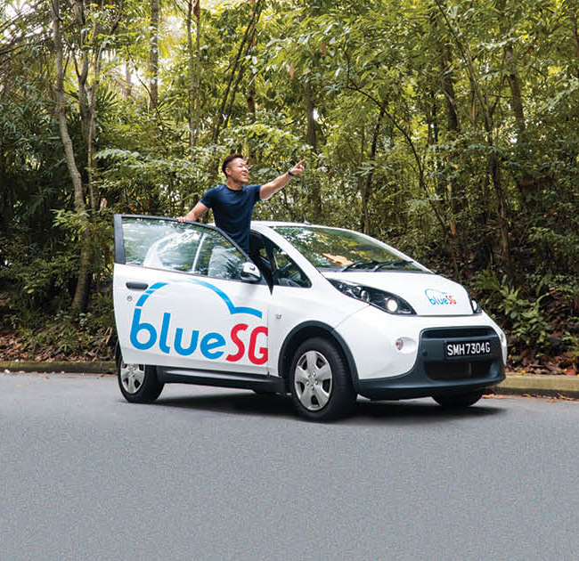

Conclusion
Achievement of Project goal
Perception or emotion opinion of BlueSG users
Potential concerns and customer pain points
Improvements
Compare it against other algorithms similarly trained based on unsupervised learning, such as naive bayes and support vector machines.
Focus on negative sentiment for more specific insights on BlueSG
Focus on more aspect-oriented sentiment analysis approach.
Notes:
Lastly to conclude my project, I have achieve my goals such that I was able to obtain sentimental perceptions of bluesg users from the tweets I obtained and find out some of the customer pain points. However, some improvements or further works on this project would be to have :
More experiments against other methodologies such as conducting navies bayes and support vector machines.
We could also focus on improving the treatment of negative sentiments as it could be more helpful in analysing more specific customer pain-points.
And lastly, focus on more aspect-oriented sentiment analysis approach which analyzes customer feedback by associating specific sentiments with different aspects of a product or service.

Slide 12
Thank You
Notes:
Notes:
Sentiment analysis is an application of natural language processing (NLP) that reveals the emotional states in human speech or text -- in this case, the speech and text that customers generate. Businesses can use machine-learning-based sentiment analysis software to examine this speech and text for positive or negative sentiment about the brand. With this information, companies have an opportunity to respond meaningfully -- and with greater empathy. The aim is to improve the customer relationship and enhance customer loyalty. Social media monitoring produces significant amounts of data for NLP analysis. Social media sentiment can be just as important in crafting empathy for the customer as direct interaction.
Few analyzers might not take the label ‘neutral’ into consideration as it merely depends on the business requirements.

